Slide 1
ECE 313: PROBABILITY WITH ENGINEERING APPLICATIONS
Fall 2023
Prof. Eric Chitambar
Lecture 21

Slide 2
Maximum Likelihood Estimation for C.V.

Slide 3
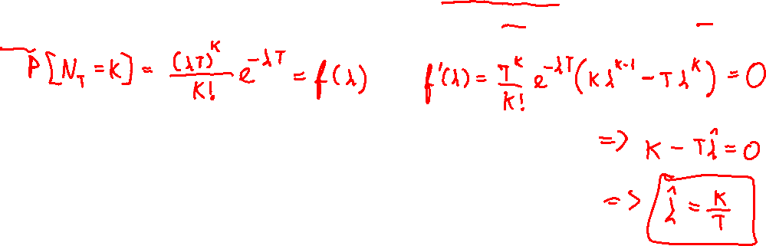
Maximum Likelihood Estimation for C.V.

Slide 4
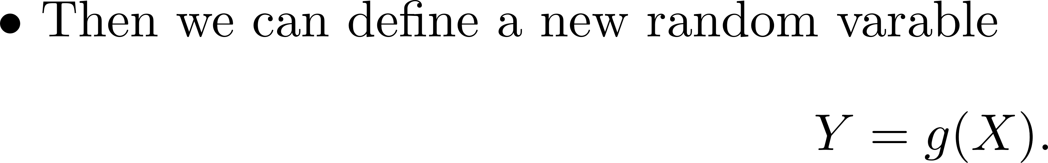
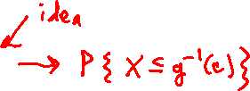
Functions of a random variable

Slide 5

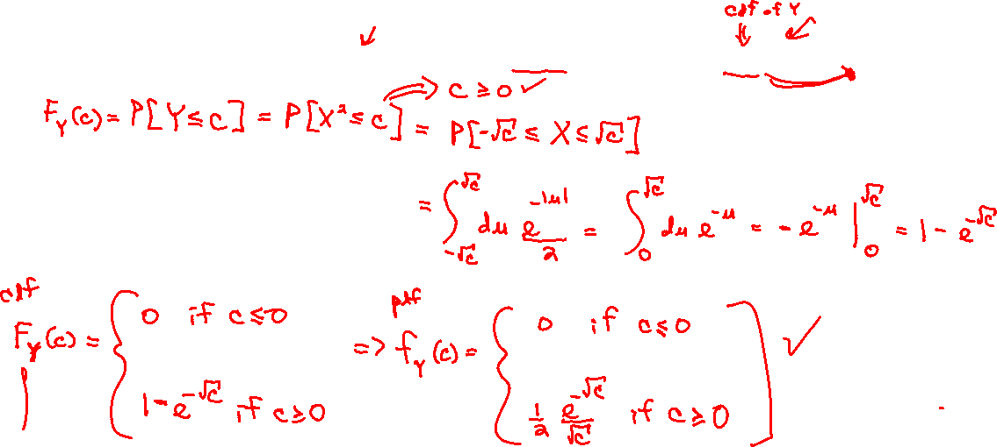
Functions of a random variable

Slide 6
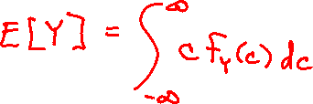
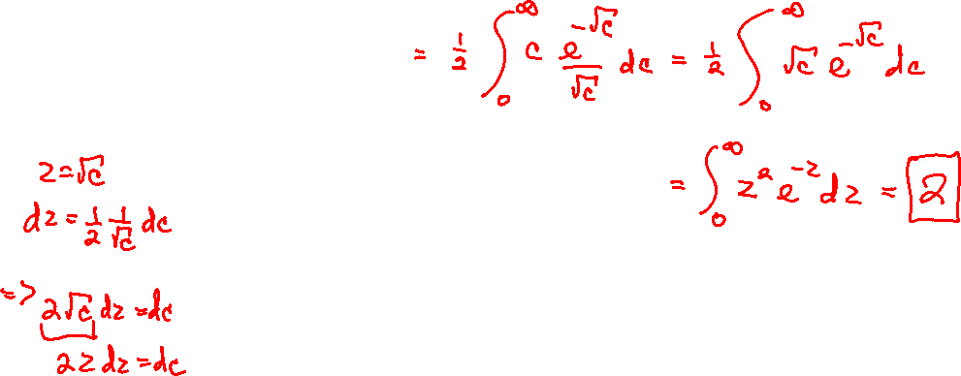
Functions of a random variable

Slide 7
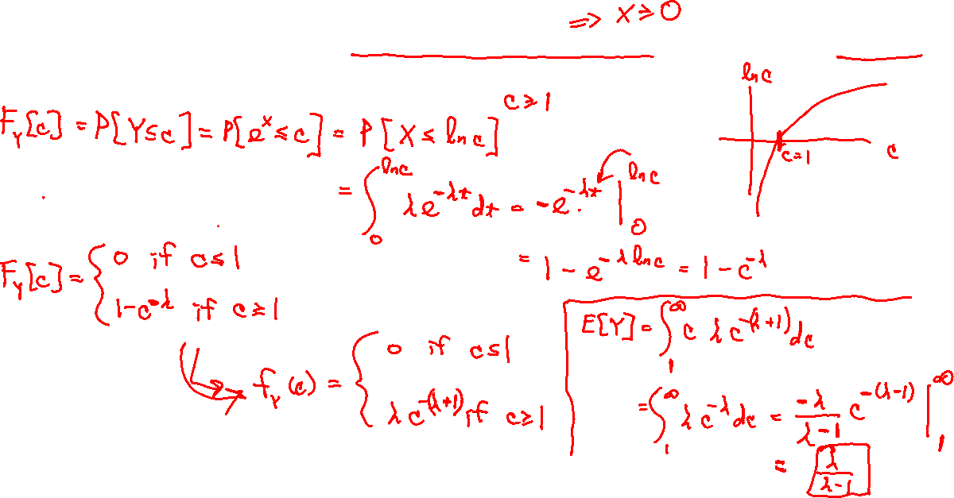
Functions of a random variable

Slide 8
Functions of a random variable

